Slide 1
Core Java

Slide 2
What is Java?
Java is a programming language and a platform. Java is a high level, robust, object-oriented and secure programming language.
Java was developed by Sun Microsystems (which is now the subsidiary of Oracle) in the year 1995.
James Gosling is known as the father of Java. Before Java, its name was Oak. Since Oak was already a registered company, so James Gosling and his team changed the name from Oak to Java.

Slide 3
Flavours Of Java
1) Java SE (Java Standard Edition)
It is a Java programming platform. It includes Java programming APIs such as java.lang, java.io, java.net, java.util, java.sql, java.math etc. It includes core topics like OOPs, String, Regex, Exception, Inner classes, Multithreading, I/O Stream, Networking, AWT, Swing, Reflection, Collection, etc.
2) Java EE (Java Enterprise Edition)
It is an enterprise platform that is mainly used to develop web and enterprise applications. It is built on top of the Java SE platform. It includes topics like Servlet, JSP, Web Services, EJB, JPA, etc.
3) Java ME (Java Micro Edition)
It is a micro platform that is dedicated to mobile applications.
4) JavaFX
It is used to develop rich internet applications. It uses a lightweight user interface API.

Slide 4
History Of Java
1) James Gosling, Mike Sheridan, and Patrick Naughton initiated the Java language project in June 1991. The small team of sun engineers called Green Team.
2) Initially it was designed for small, embedded systems in electronic appliances like set-top boxes.
3) Firstly, it was called "Greentalk" by James Gosling, and the file extension was .gt.
4) After that, it was called Oak and was developed as a part of the Green project.
5) Why Oak? Oak is a symbol of strength and chosen as a national tree of many countries like the U.S.A., France, Germany, Romania, etc.

Slide 5
History Of Java
6) In 1995, Oak was renamed as "Java" because it was already a trademark by Oak Technologies.
7) Why had they chose the name Java for Java language? The team gathered to choose a new name. The suggested words were "dynamic", "revolutionary", "Silk", "jolt", "DNA", etc. They wanted something that reflected the essence of the technology: revolutionary, dynamic, lively, cool, unique, and easy to spell, and fun to say.
According to James Gosling, "Java was one of the top choices along with Silk". Since Java was so unique, most of the team members preferred Java than other names.

Slide 6
Features
Simple
Object-Oriented
Portable
Platform independent
Secured
Robust
Architecture neutral
Interpreted
High Performance
Multithreaded
Distributed
Dynamic

Slide 7
JDK
JDK is an acronym for Java Development Kit. The Java Development Kit (JDK) is a software development environment which is used to develop Java applications and applets. It physically exists. It contains JRE + development tools.
The JDK contains a private Java Virtual Machine (JVM) and a few other resources such as an interpreter/loader (java), a compiler (javac), an archiver (jar), a documentation generator (Javadoc), etc. to complete the development of a Java Application.

Slide 8
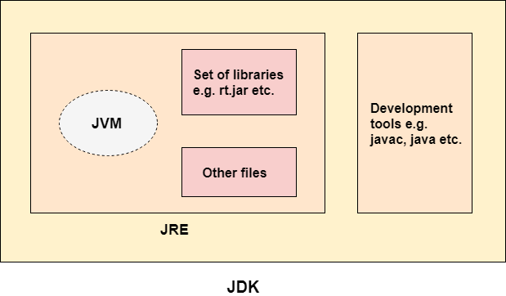
JDK , JRE , JVM

Slide 9
JRE
JRE is an acronym for Java Runtime Environment. It is also written as Java RTE. The Java Runtime Environment is a set of software tools which are used for developing Java applications. It is used to provide the runtime environment. It is the implementation of JVM. It physically exists. It contains a set of libraries + other files that JVM uses at runtime.
The implementation of JVM is also actively released by other companies besides Sun Micro Systems.

Slide 10
JVM
JVM (Java Virtual Machine) is an abstract machine. It is called a virtual machine because it doesn't physically exist. It is a specification that provides a runtime environment in which Java bytecode can be executed. It can also run those programs which are written in other languages and compiled to Java bytecode.
JVMs are available for many hardware and software platforms. JVM, JRE, and JDK are platform dependent because the configuration of each OS is different from each other. However, Java is platform independent. There are three notions of the JVM: specification, implementation, and instance.

Slide 11
The JVM performs the following main tasks:
Loads code
Verifies code
Executes code
Provides runtime environment

Slide 12
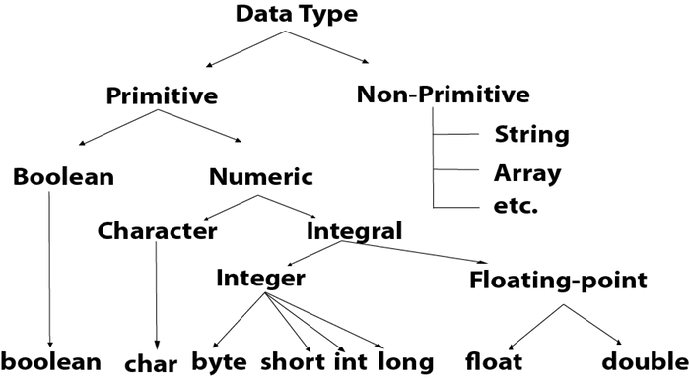

Slide 13
Data Type | Default Value | Default size
boolean | false | 1 bit
char | '\u0000' | 2 byte
byte | 0 | 1 byte = 8bits
short | 0 | 2 byte
int | 0 | 4 byte
long | 0L | 8 byte
float | 0.0f | 4 byte
double | 0.0d | 8 byte

Slide 14
Operators
Unary Operator
incrementing/decrementing a value by one
negating an expression
inverting the value of a boolean
postfix | expr++ expr--
prefix | ++expr --expr +expr -expr ~ !

Slide 15
Arithmetic Operator,
multiplicative * / %
additive + -
Relational Operator
comparison < ,> ,<= ,>=
equality == , !=
Logical Operator
logical AND &&
logical OR ||

Slide 16
Ternary Operator
Java Ternary operator is used as one line replacement for if-then-else statement and used a lot in Java programming. It is the only conditional operator which takes three operands.
ternary ? :
Assignment Operator.
assignment = ,+= ,-= ,*= ,/= ,%= ,&= ,^=,

Slide 17
Java Control Statements | Control Flow in Java
Java compiler executes the code from top to bottom. However, Java provides statements that can be used to control the flow of Java code. Such statements are called control flow statements. Java provides three types of control flow statements.
Decision Making statements
if statements
switch statement
Loop statements
do while loop
while loop
for loop
for-each loop
Jump statements
break statement
continue statement

